Slide 1




ABP Webinar
Alper Ebicoglu
alperebicoglu
ABP Team Leader
ebicoglu

Slide 2

Agenda
7️⃣ Learning & Community
- How to Learn ABP?
- Documentation
- Essential Videos
- Books
- Samples
- Community Articles
- Discord
- Support Site
- Services
8️⃣ Demos
- Live Demo Website: https://abp.io/demo
- Hands-on: Creating a New ABP Project
- How it Works
- Using ABP CLI
- Creating a New Project via Studio
- Running & Navigating the Generated Project
- Generating a CRUD Page via Suite
1️⃣ Opening
- Welcome
- What’s ABP?
- Why ABP?
- Who’s ABP For?
2️⃣ The ABP Platform
- Overview: Open-Source & Paid License
- Architecture & Core Features
- Startup Templates & DB Providers
3️⃣ UI & Experience
- LeptonX UI Theme
- Live Demo: https://leptontheme.com/
4️⃣ Productivity Tools
- ABP CLI
- ABP Suite
- ABP Studio
5️⃣ Pre-Built Modules & Mobile
- Pre-Built Modules
- Mobile App
6️⃣ Licensing & Pricing
- License / Pricing
9️⃣ Wrap-up
- Our Customers
- Discount for You
- FAQ Page
- How to Reach Us
- Your Questions

Slide 3
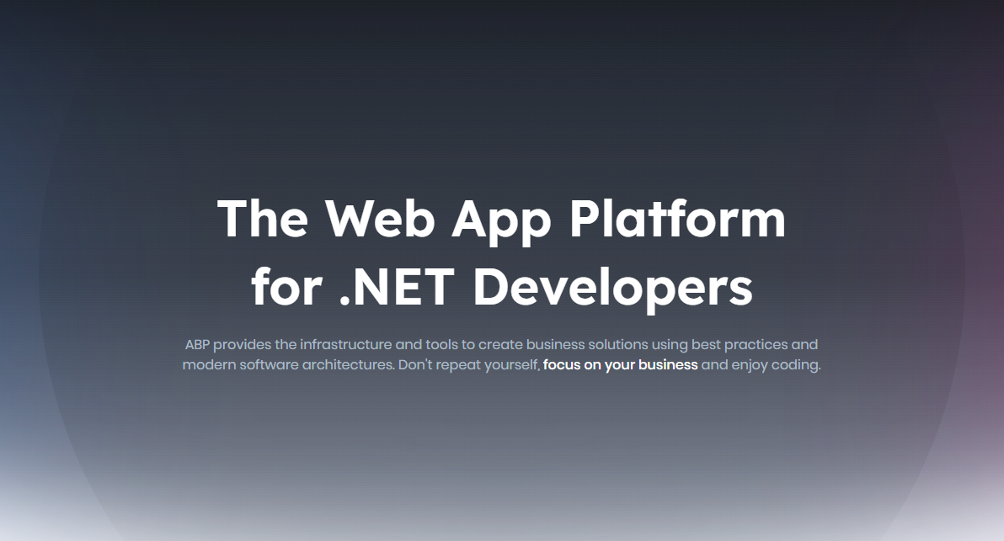
Notes:
What’ ABP?
ABP (abp.io) is an open-source application development framework built on ASP.NET Core. It provides a full-stack, modular, and enterprise-ready foundation to build modern web applications and APIs.
When you start a new ASP.NET Project, you either start from scratch or clone an existing solution which is similar your new Project.
Starting a new Project is very hard these days. Because you need to integrate authentication library, decide client-side packages, build a proper solution architecture, implement generic features like validation, exception handling, auditing, caching, localization, setting Management, or if it’s a SaaS app, multi-tenancy. All these need experience and even if you are an experienced developer, these are time-consuming.
Why ABP? ->

Slide 4
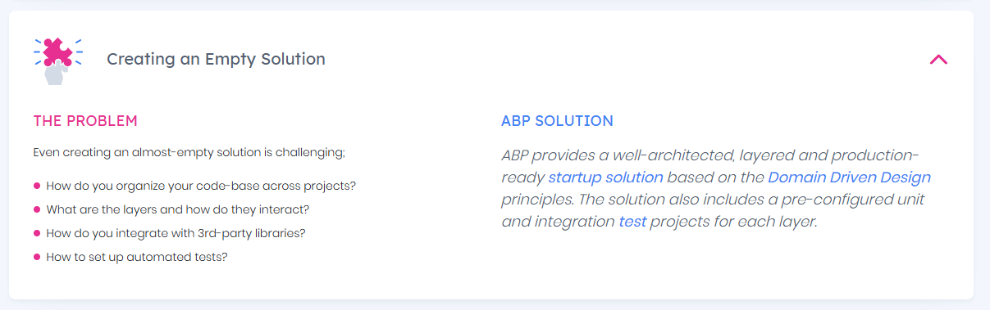
Why ABP?
Notes:
Why ABP?
Why ABP? In this point, ABP fills a gap between the raw ASP.NET Core and a full-stack working application. It comes with built-in code that handles things like authentication, authorization, multi-tenancy, and microservices. We’ve been building developer tools for over 10 years, and ABP is backed by a strong open-source community.
When you start a new ABP project, you’ll have a working app on day one—login and user pages, role management, OpenID authentication, and a clean architecture based on Domain-Driven Design. This makes it easy for new team members to join and understand the project.
ABP also gives you tools to generate CRUD pages, manage microservices, track errors, and monitor requests across services. You can customize everything without touching the source code, but if you need it, full source code is included.
Everything is well-documented, so your team can find answers without asking the lead developer. Plus, you can reach out to our technical support anytime. And soon, ABP Studio will include an AI assistant trained on ABP to help even faster.
Would you like me to make it even shorter—like a quick 1-minute pitch—or keep this length for a 2-3 minute explanation?

Slide 5
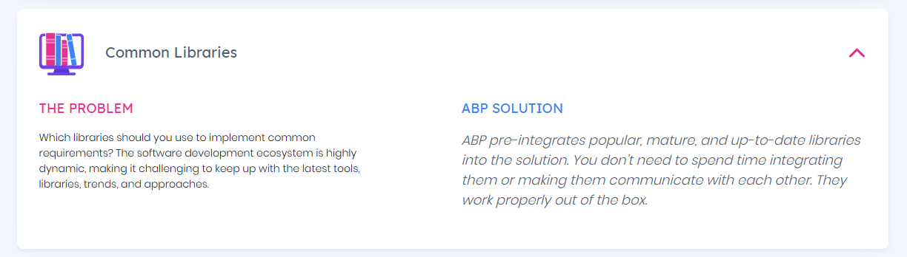
Why ABP?

Slide 6
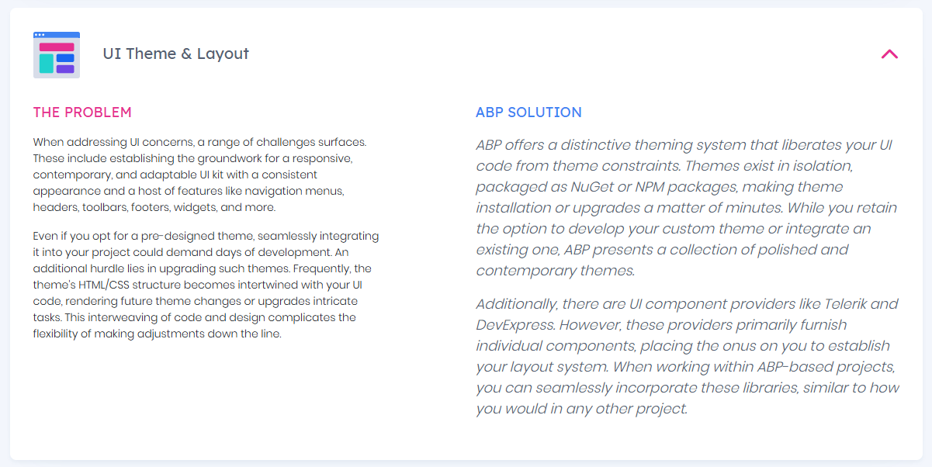
Why ABP?

Slide 7
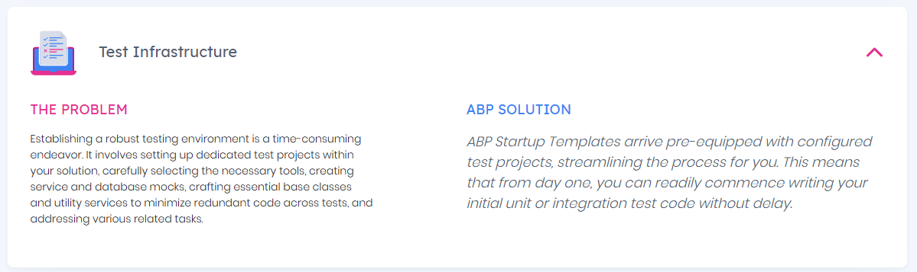
Why ABP?

Slide 8
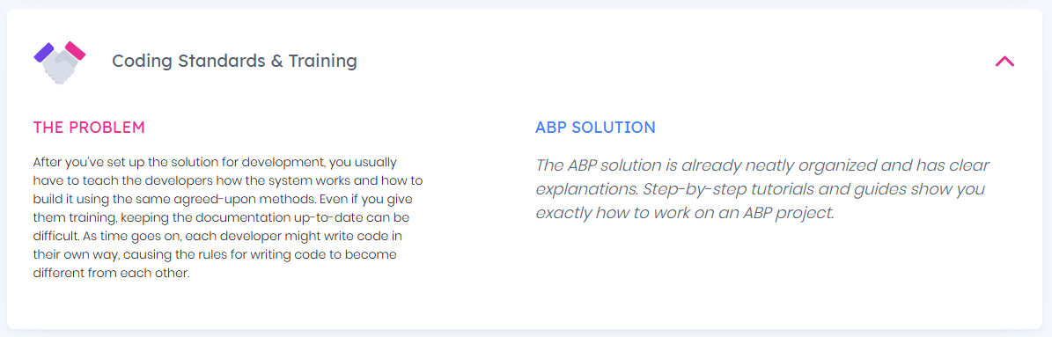
Why ABP?

Slide 9
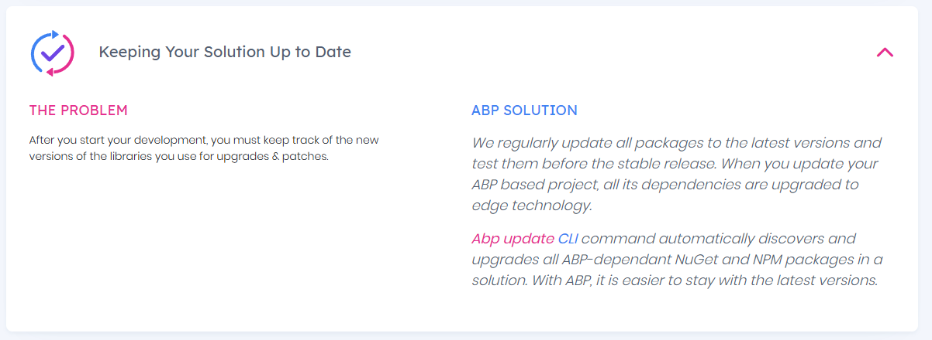
Why ABP?

Slide 10
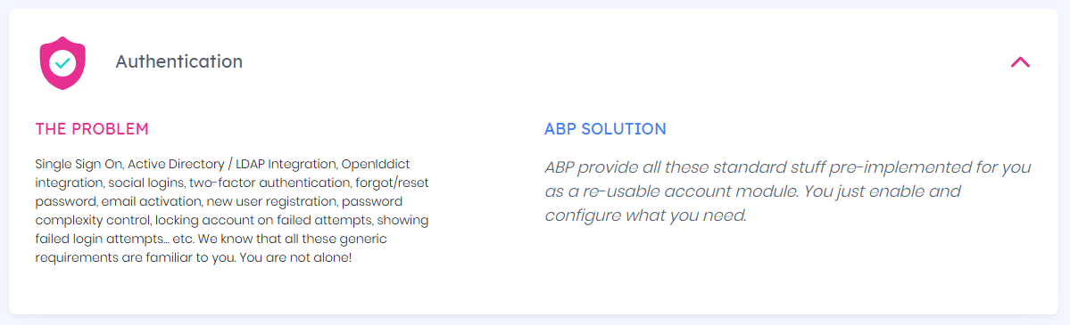
Why ABP?

Slide 11
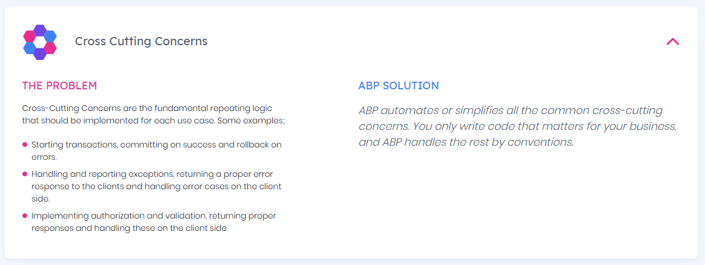
Why ABP?

Slide 12
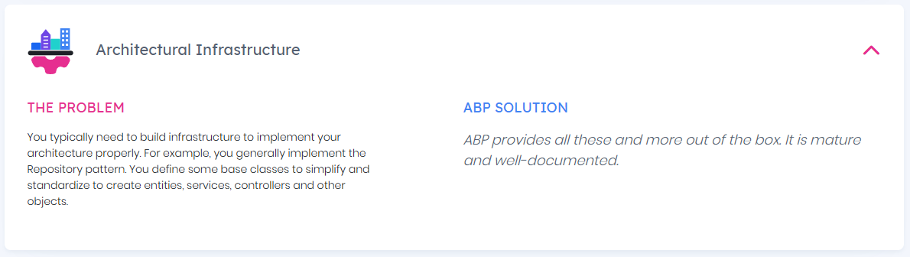
Why ABP?

Slide 13
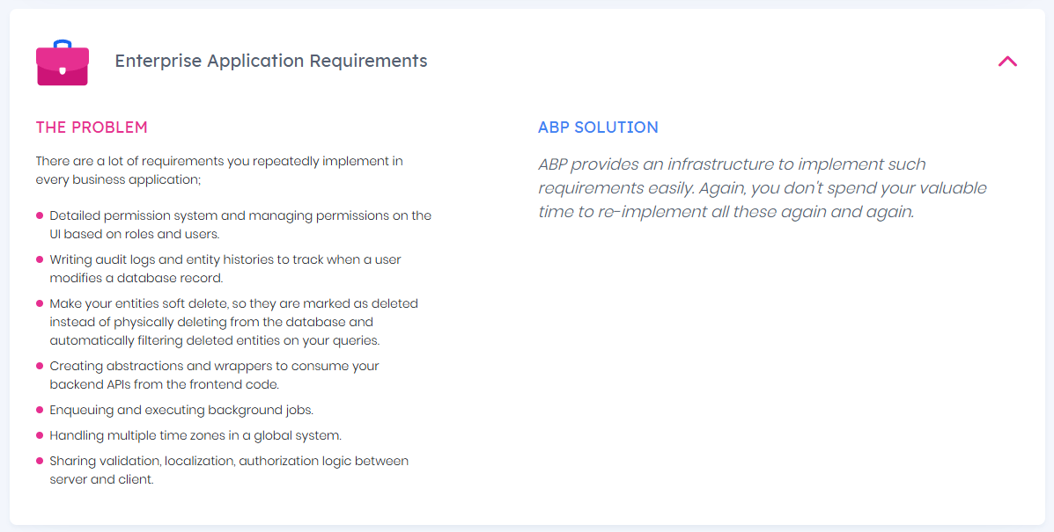
Why ABP?

Slide 14
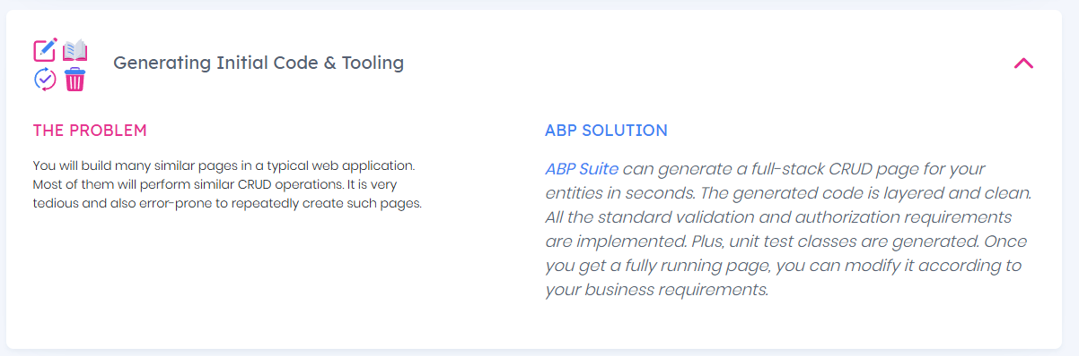
Why ABP?

Slide 15
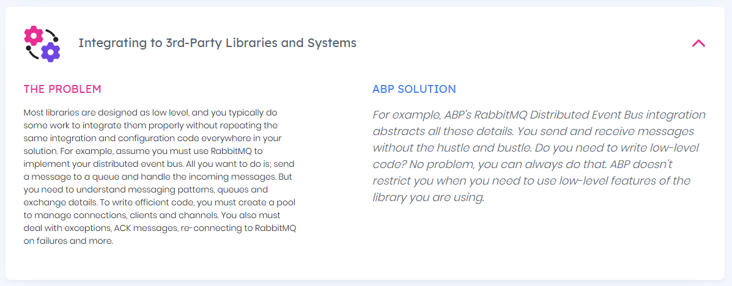
Why ABP?

Slide 16
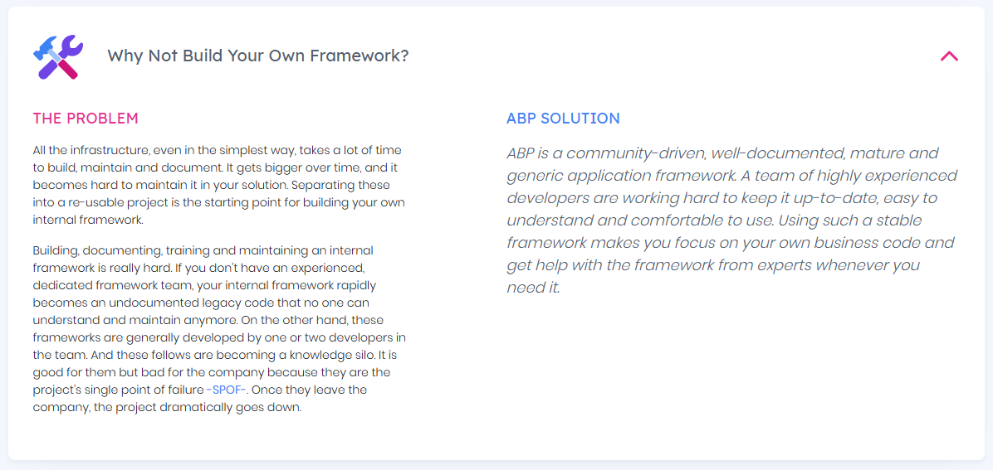
Why ABP?

Slide 17
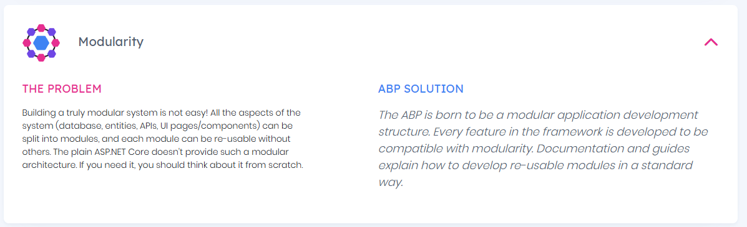
Why ABP?

Slide 18
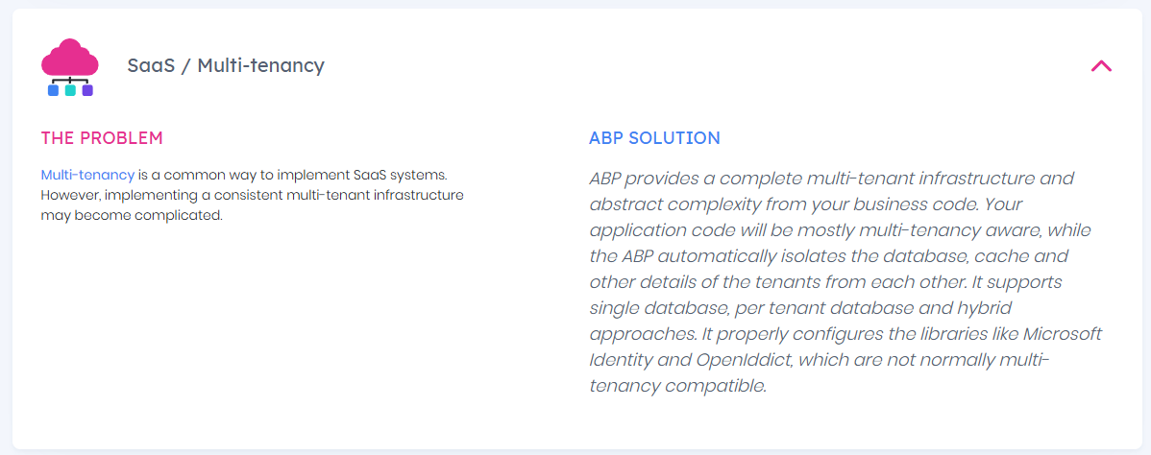
Why ABP?

Slide 19
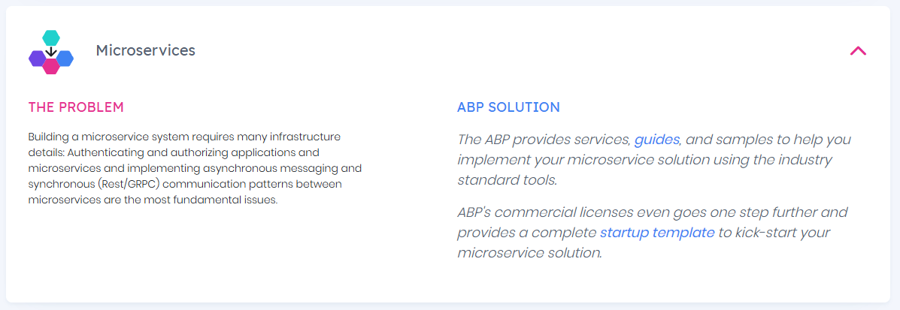
Why ABP?

Slide 20
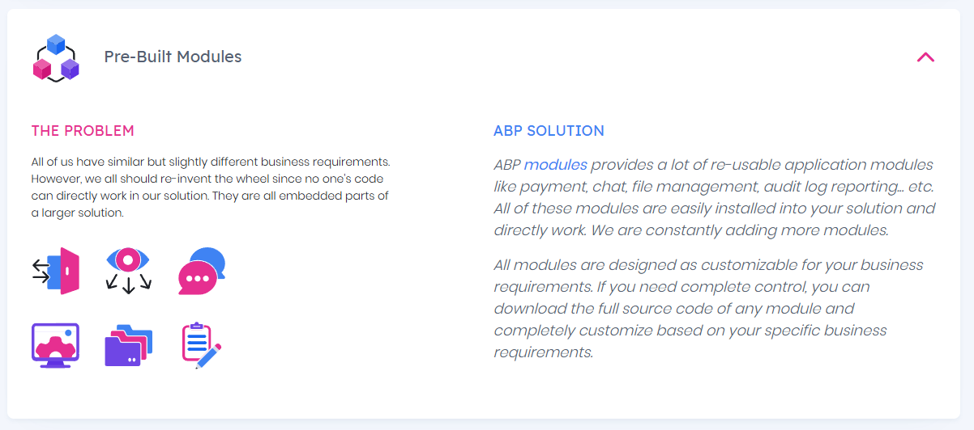
Why ABP?

Slide 21
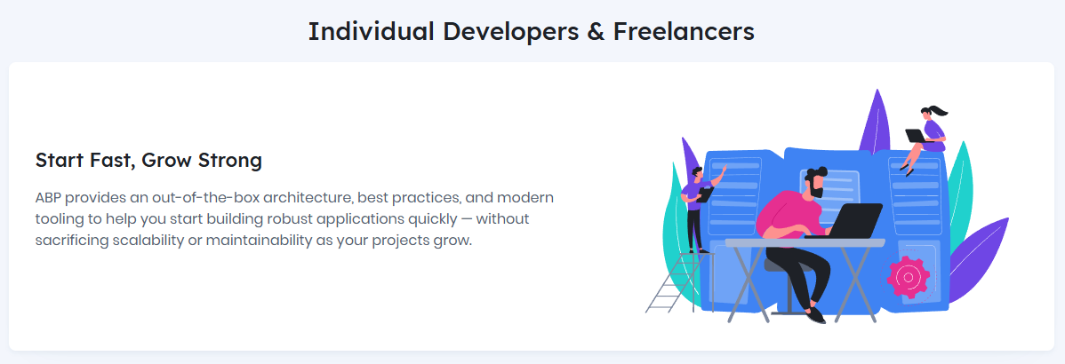
Who’s ABP for?

Slide 22
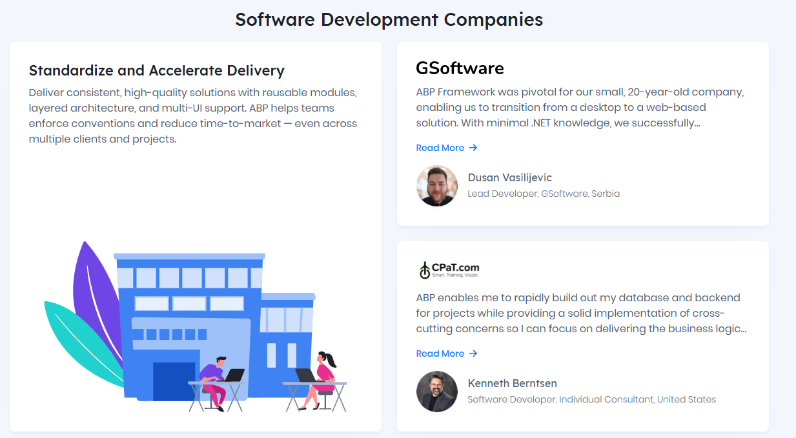
Who’s ABP for?

Slide 23
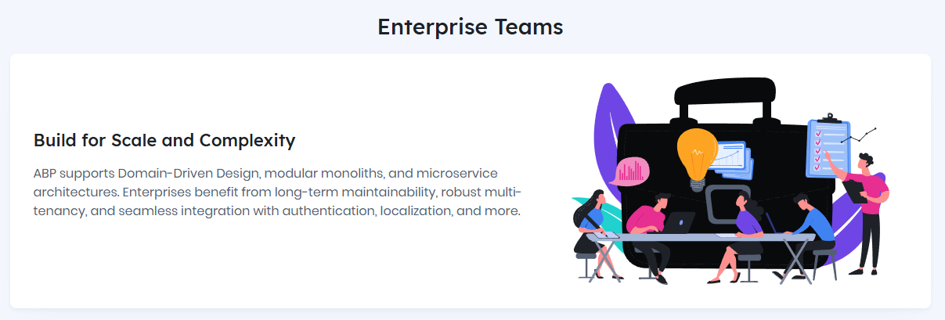
Who’s ABP for?

Slide 24
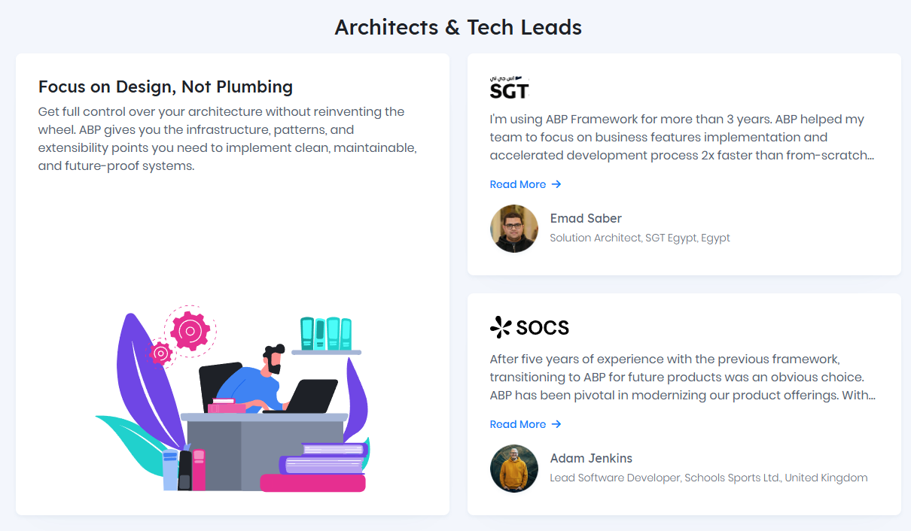
Who’s ABP for?

Slide 25
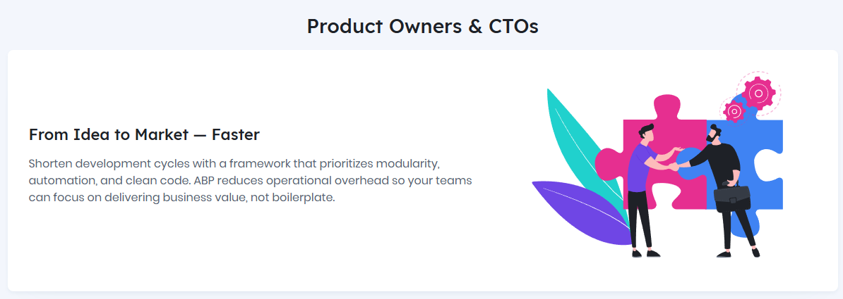
Who’s ABP for?

Slide 26
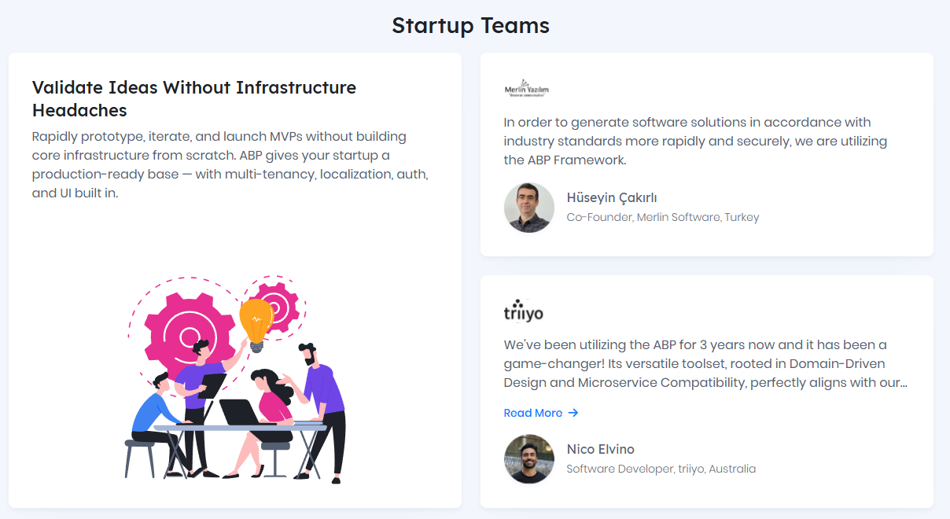
Who’s ABP for?

Slide 27
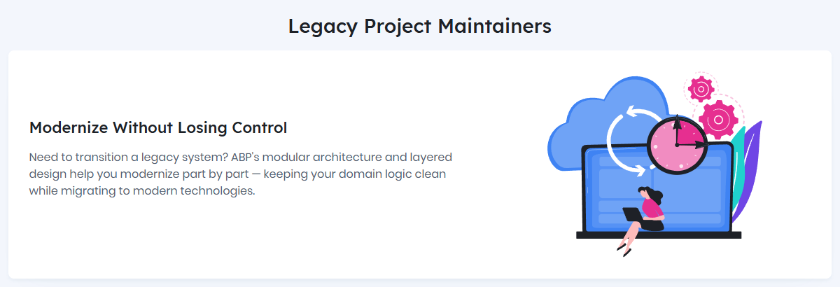
Who’s ABP for?

Slide 28
Live Demo Website
https://abp.io/demo ➡
Notes:
https://abp.io/demo

Slide 29
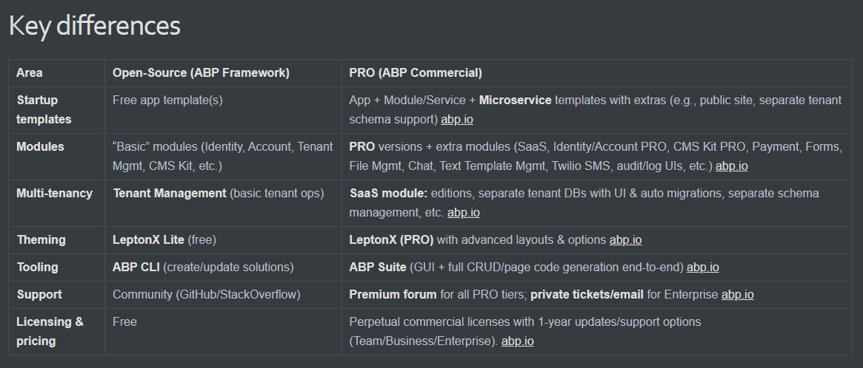
Open-source and Commercial Differences
Notes:
ABP started its life as open-source in 2017. We created a microservice compliant, multi-tenant web application Framework. Now it’s almost 14K stars on GitHub.
ABP Framework (open-source): the free, community-driven foundation—architecture, starter templates, CLI, LeptonX Lite theme, and a set of “basic” modules. abp.io
Choose PRO if you need to ship faster with out-of-the-box SaaS features, richer modules, enterprise-grade theming, code generation, and guaranteed support/SLA. Typical for teams, ISVs, and multi-tenant products

Slide 30
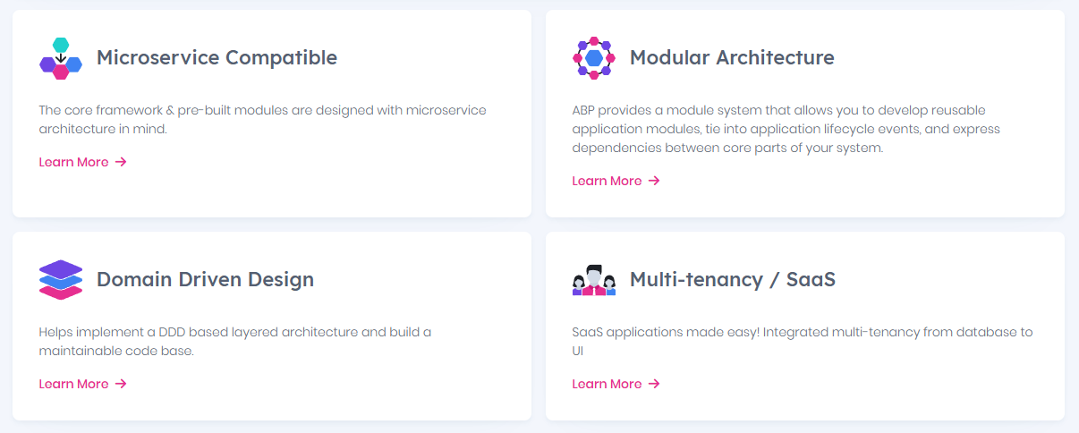
Architecture
Notes:
MICROSERVICE
Scalability
Scale individual services based on demand, optimizing resource usage.
Flexibility
Use different technologies (e.g., .NET, Node.js) and databases per service.
Resilience
Isolate failures to specific services, improving overall system reliability.
Team Autonomy
Enable parallel development by independent teams.
Continuous Deployment
Deploy updates to one service without affecting others.
MODULAR ARCHITECTURE
Simplified Development and Deployment
Maintaining a single codebase and deployment pipeline reduces complexity compared to microservices architectures.
Enhanced Maintainability
Clear module boundaries facilitate easier updates and maintenance, as changes can be made within a module without affecting others.
Scalability Potential
While starting as a monolith, the modular structure allows individual modules to be extracted into microservices if scaling needs to evolve.
Parallel Development
Multiple teams and developers can work on different modules in parallel without affecting each other
DOMAIN DRIVEN DESIGN
DDD is best suited for complex domains and large-scale applications. However, for systems where the core logic is complex and evolves over time, applying DDD principles and patterns can lead to a significantly more flexible, modular, and maintainable code base. ABP applies DDD rules in all the templates.
MULTI-TENANCY
In ABP projects multi-tenancy can be on and off just with a boolean flag. Rest of the work is done by ABP. Tenants can share the same database or they can have dedicated db. Each tenant can have different configurations and settings. You can use subdomains to identify tenants. You can enable disable multi-tenancy within your custom code to Access all the tenants data. All the entities are automatically set tenant ID,
or when you fetch data from database it’ll bring only the active tenants data. no need to do manual work for tenancy.

Slide 31
ABP’s Features
Multiple UI Options
Multiple Database Providers
ABP CLI
Modularity
Multi-tenancy
Bootstrap Tag Helpers
Dynamic Forms
Authentication & Authorization
Cross Cutting Concerns
Concurrency Check
Bundling & Minification
Virtual File System
Theming
Background Jobs
Background Workers
DDD Infrastructure
Auto REST APIs
Cancellation Support
Dynamic Client Proxies
Distributed Event Bus
Distributed Locking
BLOB Storing
Text Templating
Test Infrastructure
Audit Logging
Object to Object Mapping
Email & SMS Abstractions
Localization
Setting Management
Extension Methods
Aspect Oriented Programming
Dependency Injection
Data Filtering
Encryption & Decryption
Dynamic Forms
Authentication & Authorization
Cross Cutting Concerns
Concurrency Check
Bundling & Minification
Virtual File System
Theming
Background Jobs
Background Workers
DDD Infrastructure
Auto REST APIs
Cancellation Support
Dynamic Client Proxies
Distributed Event Bus
Distributed Locking
BLOB Storing
Text Templating
Test Infrastructure
Audit Logging
Object to Object Mapping
Email & SMS Abstractions
Localization
Setting Management
Extension Methods
Aspect Oriented Programming
Dependency Injection
Data Filtering
Encryption & Decryption Services
https://abp.io/framework
Notes:
https://abp.io/Framework

Slide 32
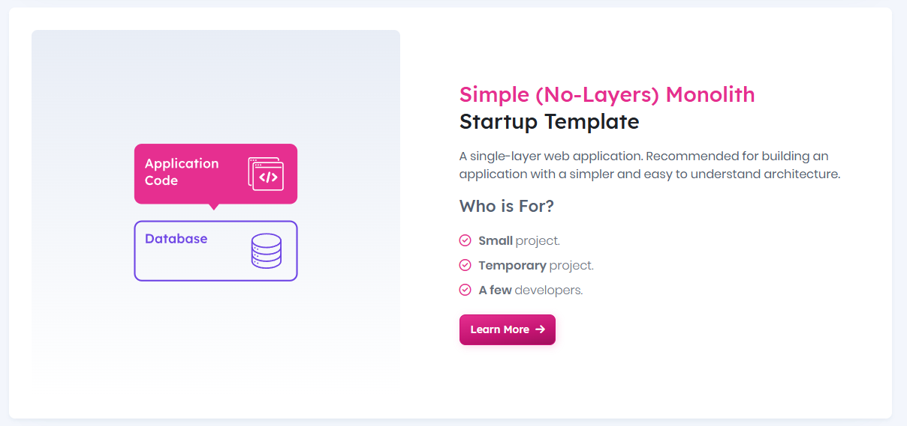
Startup Templates

Slide 33
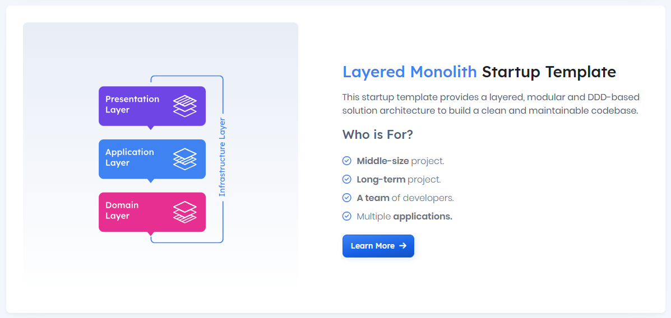
Startup Templates

Slide 34
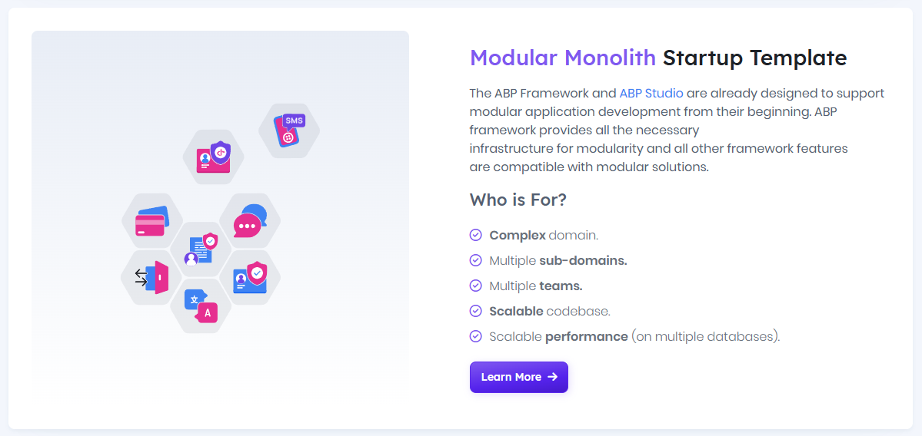
Startup Templates

Slide 35
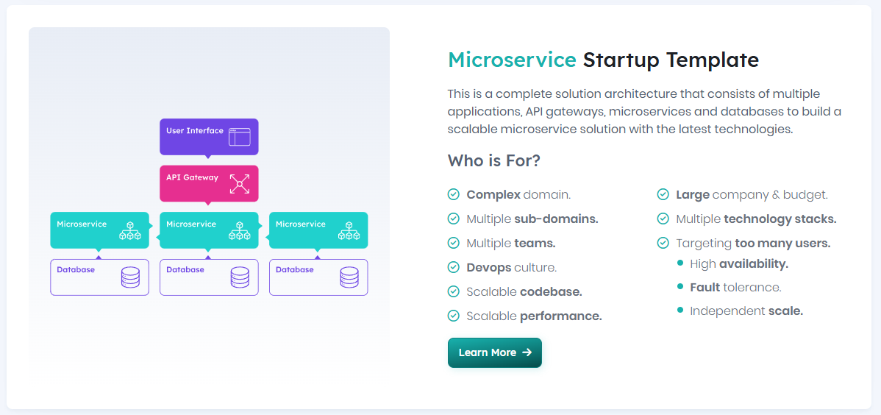
Startup Templates

Slide 36
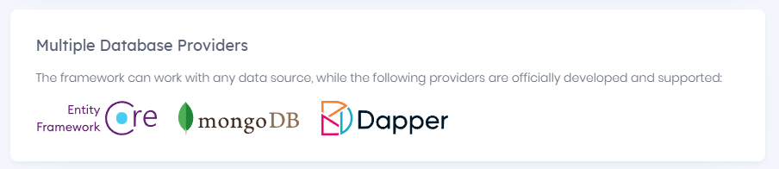
Supported DB Providers
SUPPORTED by EF CORE
Microsoft.EntityFrameworkCore.SqlServer
Microsoft.EntityFrameworkCore.Sqlite
Microsoft.EntityFrameworkCore.InMemory
Microsoft.EntityFrameworkCore.Cosmos
Npgsql.EntityFrameworkCore.PostgreSQL
Pomelo.EntityFrameworkCore.MySql
MySql.EntityFrameworkCore
Oracle.EntityFrameworkCore
MongoDB.EntityFrameworkCore
Couchbase.EntityFrameworkCore
Devart.Data.MySql.EFCore
Devart.Data.Oracle.EFCore
Devart.Data.PostgreSql.EFCore
Devart.Data.SQLite.EFCore
Devart.Data.DB2.EFCore
Devart.Data.Bigcommerce.EFCore
Devart.Data.Dynamics.EFCore Devart.Data.FreshBooks.EFCore
Devart.Data.Magento.EFCore
Devart.Data.MailChimp.EFCore
Devart.Data.QuickBooks.EFCore
Devart.Data.Salesforce.EFCore
Devart.Data.ExactTarget.EFCore
Devart.Data.Sugar.EFCore
Devart.Data.Zoho.EFCore
Devart.Data.ZohoBooks.EFCore
Devart.Data.ZohoDesk.EFCore
MASES.EntityFrameworkCore.KNet
InterBase
FirebirdSql.EntityFrameworkCore.Firebird
IBM.EntityFrameworkCore
IBM.EntityFrameworkCore-lnx
IBM.EntityFrameworkCore-osx
EntityFrameworkCore.Jet
Google.Cloud.EntityFrameworkCore.Spanner
Teradata.EntityFrameworkCore
FileContextCore
FileBaseContext
EntityFrameworkCore.SqlServerCompact35
EntityFrameworkCore.SqlServerCompact40
EntityFrameworkCore.OpenEdge
EFCore.Snowflake

Slide 37
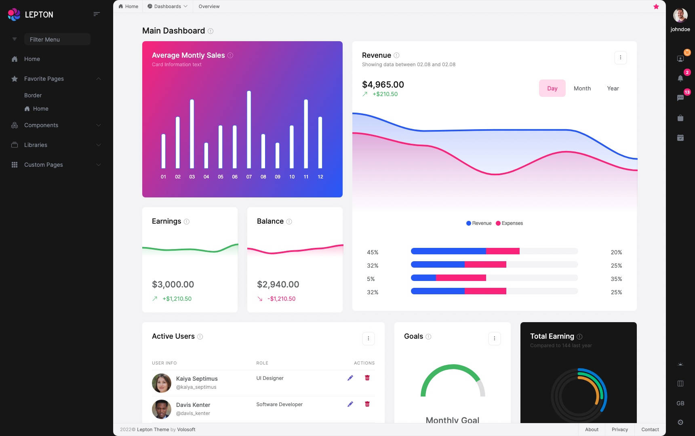
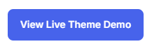
LeptonX UI Theme
https://leptontheme.com/
Notes:
https://leptontheme.com/
https://x.leptontheme.com/side-menu

Slide 38
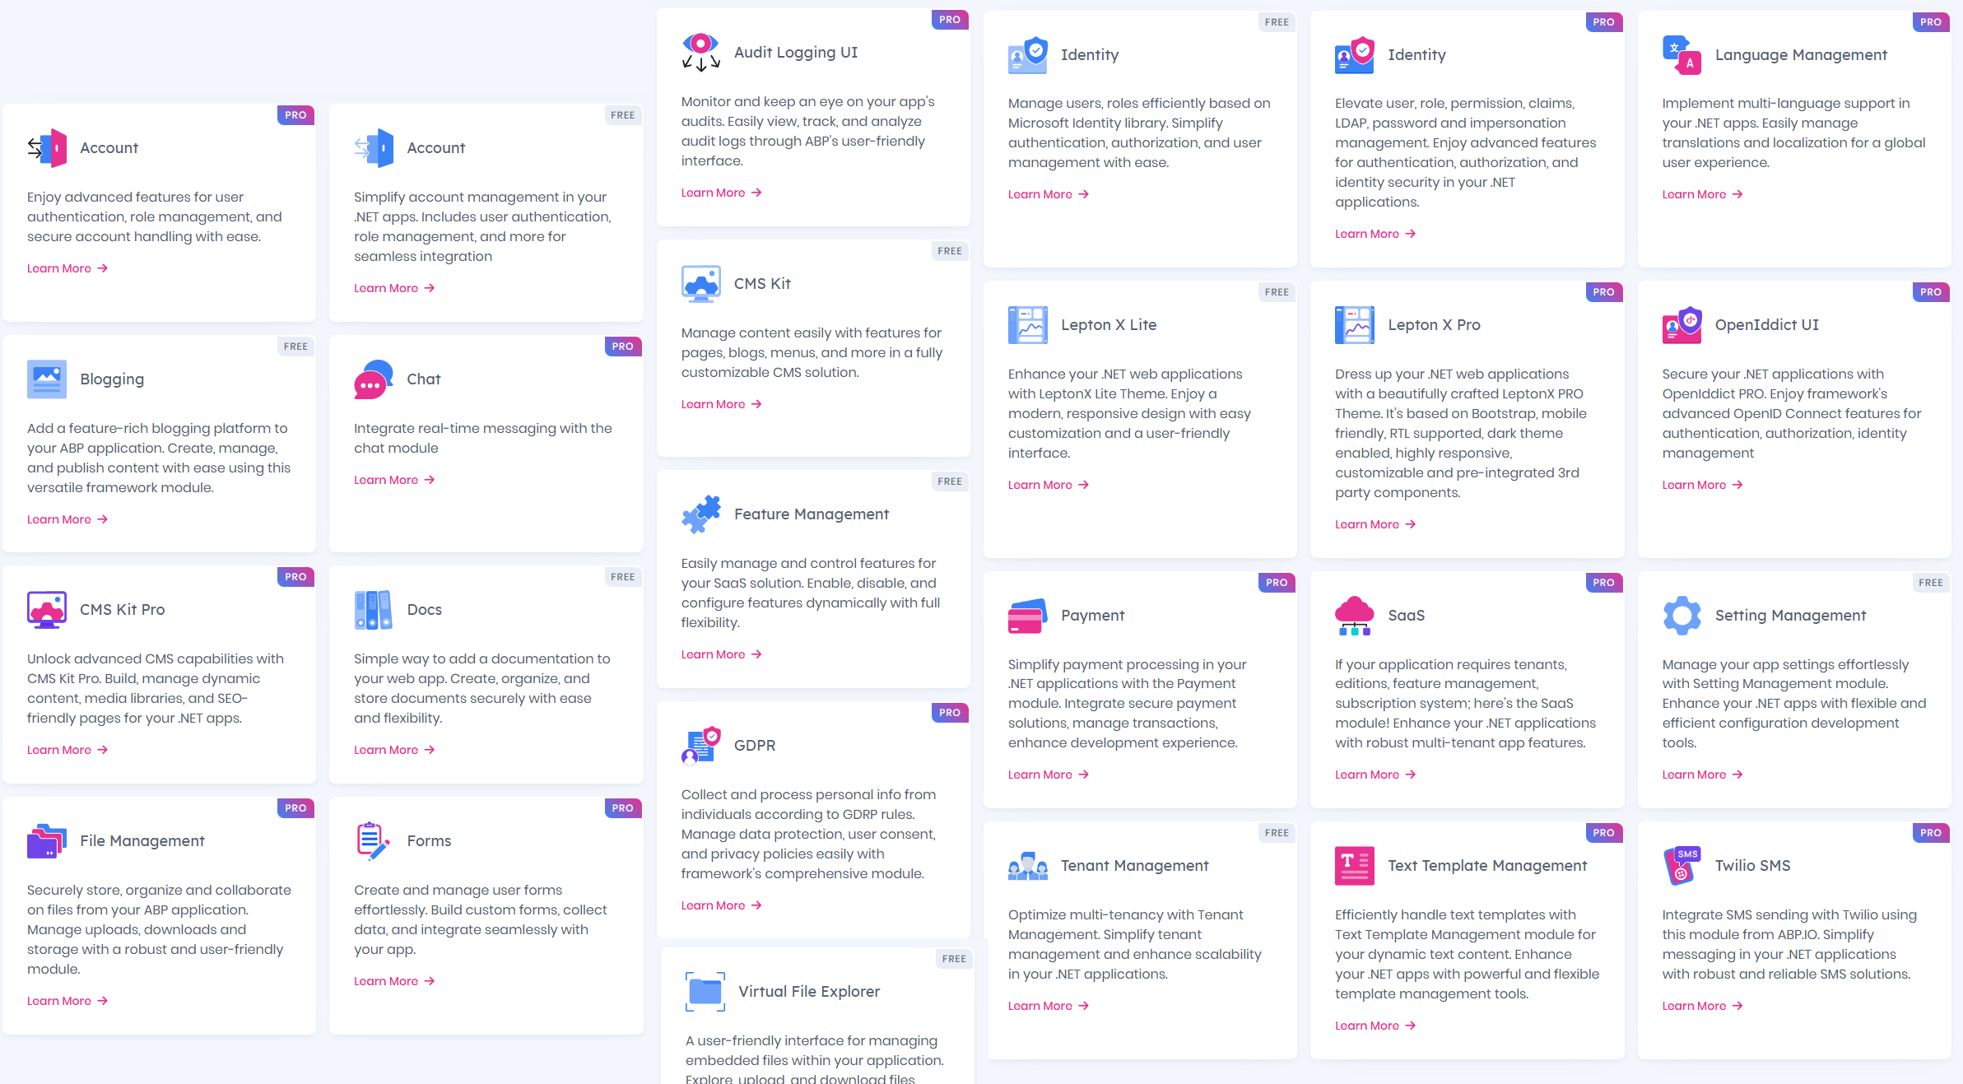
Pre-Built Modules
https://abp.io/modules
Notes:
https://abp.io/modules

Slide 39
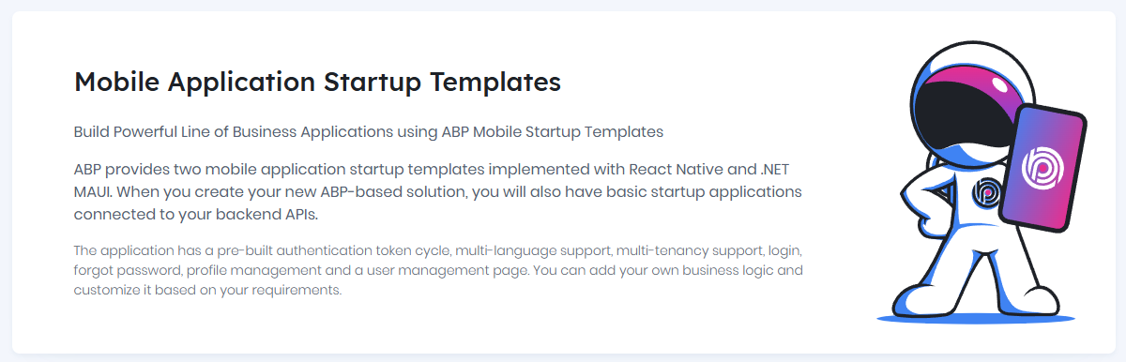
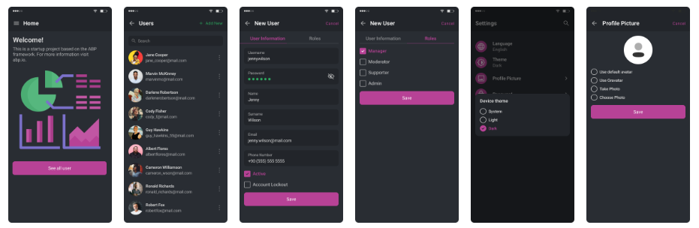

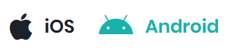
Mobile App
Notes:
Two Framework Options
ABP provides both React Native and .NET MAUI mobile startup templates. This way, you can choose the one that best suits your needs. Both apps reuse code at the highest rate between iOS and Android platforms.
ABP Mobile applications are pre-integrated to your backend APIs. It gets a valid authentication token from the server and makes authenticated requests.

Slide 40
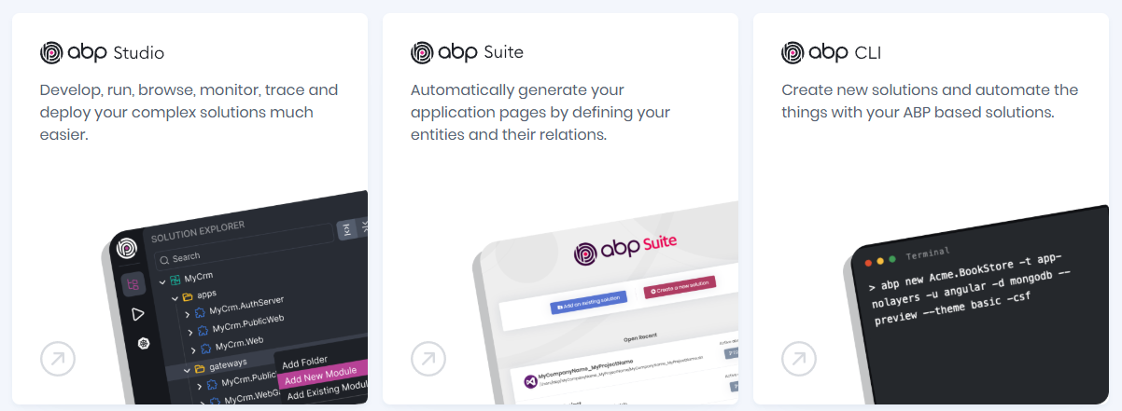

Productivty Tools
Notes:
Studio: Create New Solutions, Build monolith-modular and microservice solution structures easier by creating modules or services and establishing relations between them. You can also install or uninstall pre-built application modules. You can explore entities, services, HTTP APIs and much more without needing to open your codebase. Run one, multiple or all services with a single click. See details of all HTTP requests coming to any service.
Explore exception details as real-time in any service, easily filter and search.
Show the application logs, filter by log level or search by text.
Connect your local development environment to your Kubernetes cluster, where that cluster already runs your microservice solution.
Suite: ABP Suite allows you to easily create CRUD pages. You just need to define your entity and its properties and ABP Suite will generate related backend, frontend files for you!.
CLI: Create new solutions, upgrade existing solutions, add modules, install packages, bundle your resources and much more…

Slide 41
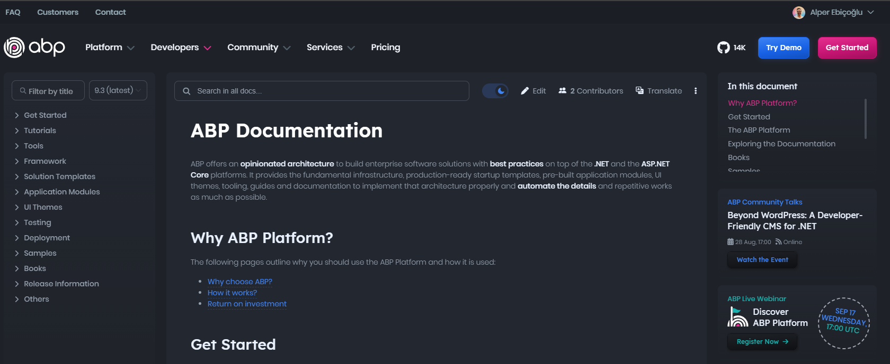
Learning ABP
abp.io/docs

Slide 42
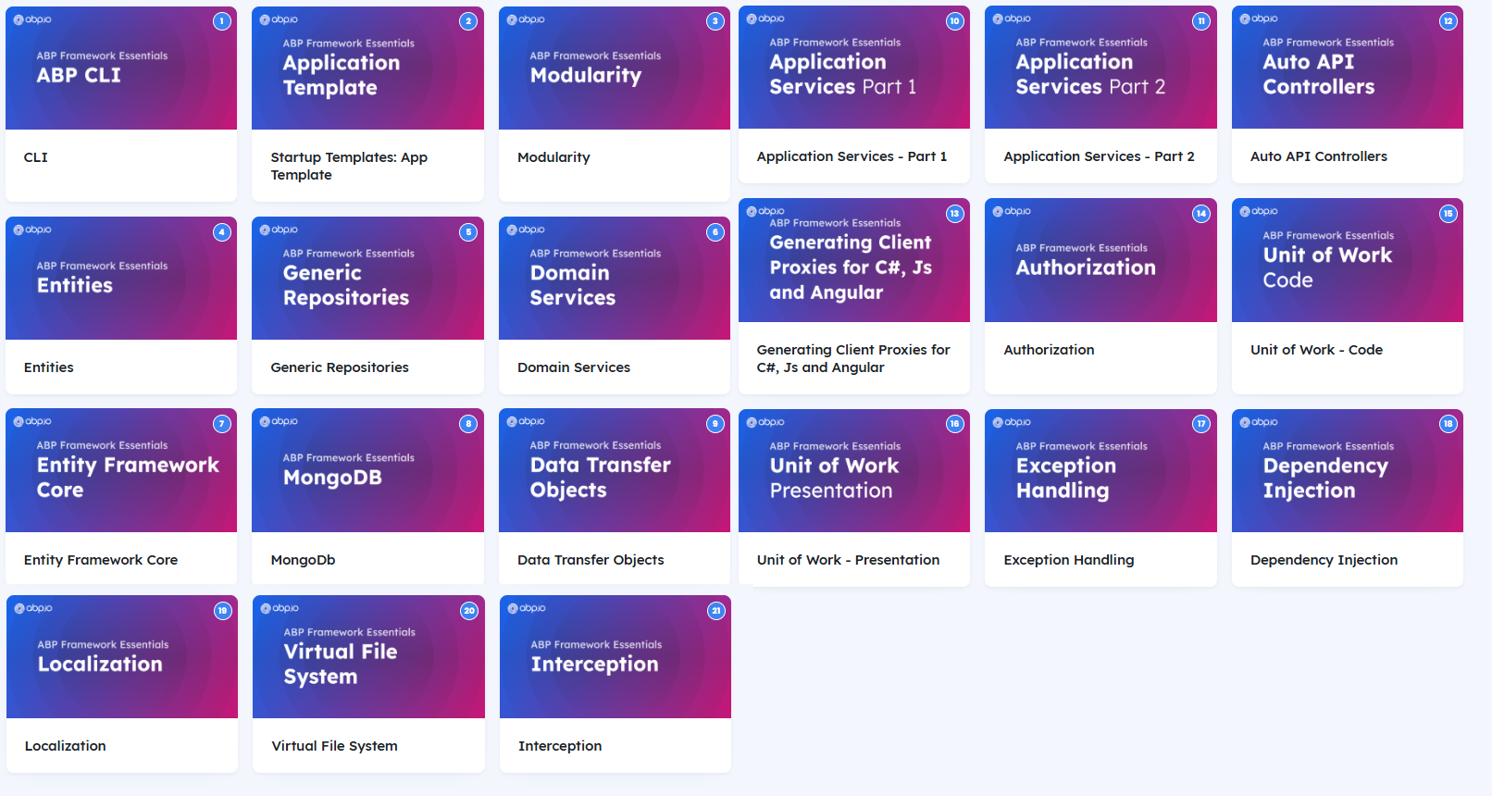
Learning ABP
abp.io/video-courses/essentials

Slide 43
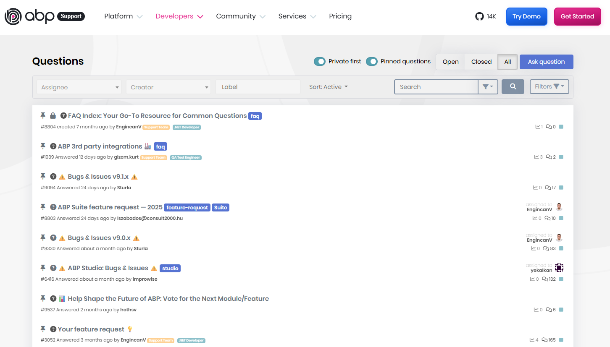
Learning ABP
abp.io/support

Slide 44
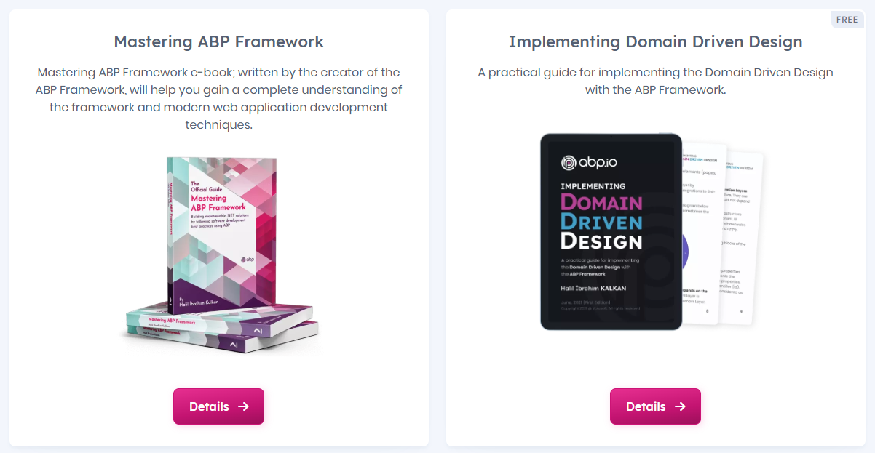
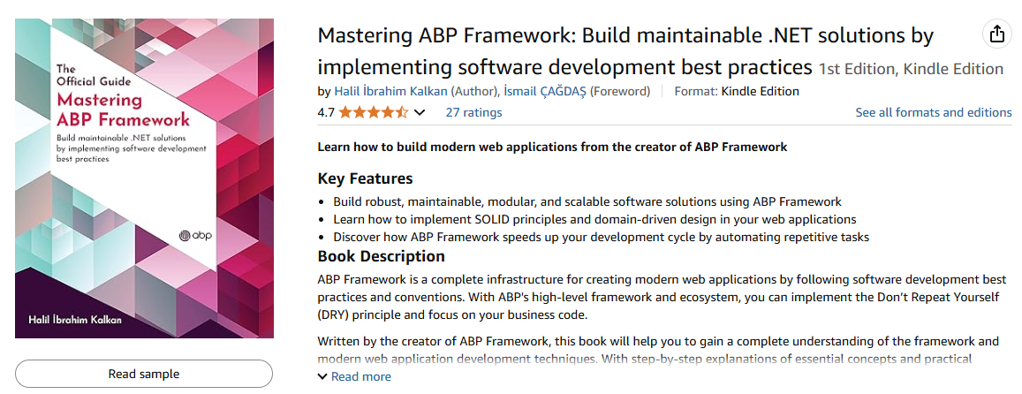
Learning ABP
abp.io/books
https://www.amazon.com/gp/product/B097Z2DM8Q

Slide 45
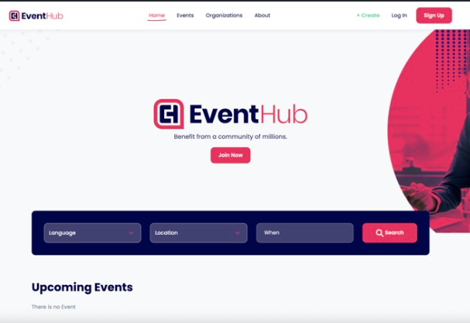
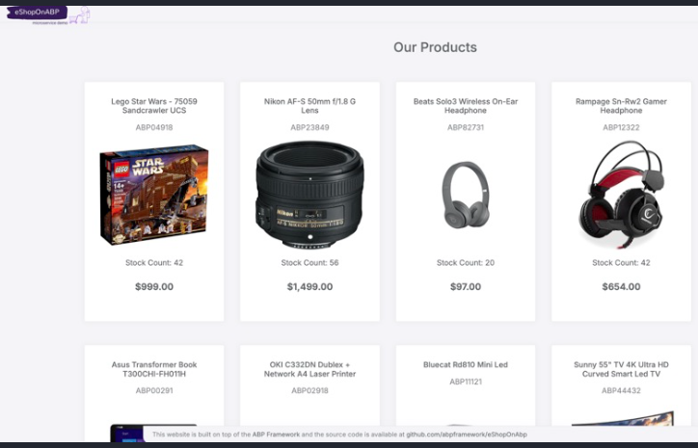
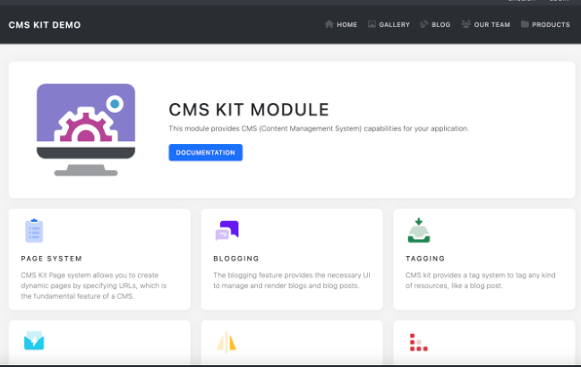
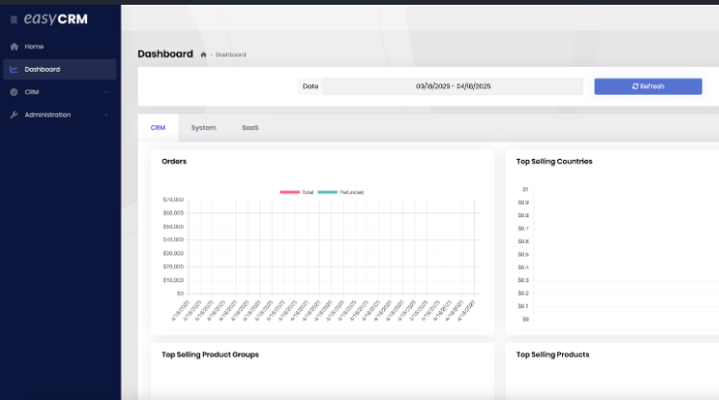
Learning ABP
abp.io/docs/latest/samples
Notes:
https://github.com/abpframework/modular-monolith-demo

Slide 46
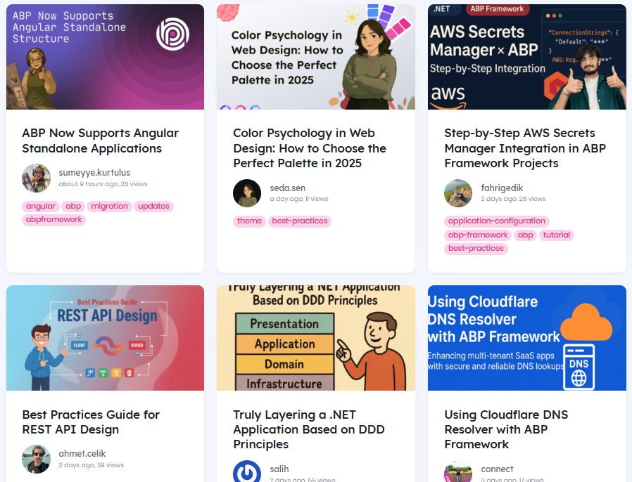
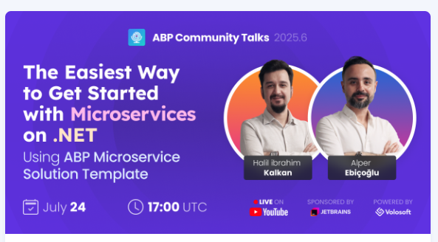


Learning ABP
abp.io/community
Live YouTube Events
Articles
Videos

Slide 47

Learning ABP
abp.io/community/discord

Slide 48

Reach Us
abp.io/contact
📨 sales@volosoft.com
📨 info@abp.io

Slide 49
Discount Code
https://abp.io/pricing?discount-code=f8801d617f2a

Slide 50
Hands-on ABP Demo
Creating a New Project via Studio
Running & Navigating the Generated Project
Generating a CRUD Pages via Suite

Slide 51
Thank You
Alper Ebicoglu
alperebicoglu
ABP Team Leader
ebicoglu

